Slide 1
Digital Portfolio
STUDENT NAME: AAFRIN TAJ M
REGISTER NO:2428C0064
NMID: 1158E3C110BFED5AF4842E9BF066C8A8
DEPARTMENT: Bsc.Artificial intelligence and machine learning
COLLEGE: Sri Krishna Adithya college of arts and science

Slide 2
DIGITAL PORTFOLIO

Slide 3


AGENDA
Problem Statement
Project Overview
End Users
Tools and Technologies
Portfolio design and Layout
Features and Functionality
Results and Screenshots
Conclusion
Github Link
3/21/2024 Annual Review

Slide 4

PROBLEM STATEMENT
Many individuals struggle to effectively showcase their skills, projects, and achievements using traditional resumes or paper portfolios, which lack interactivity and visual appeal. In a competitive digital environment, there is a need for a responsive and customizable digital portfolio that allows users to present their work in an organized, engaging, and accessible manner. This project aims to develop a digital portfolio that includes sections for personal information, skills, education, experience, projects, and certifications, while supporting multimedia content and cross-device compatibility.

Slide 5
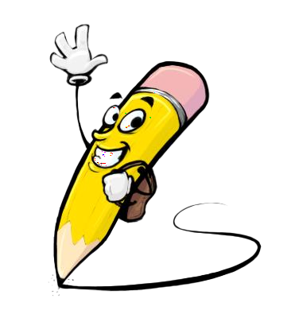
PROJECT OVERVIEW
This project involves the design and development of a digital portfolio website that enables users to professionally present their personal and professional information online. The portfolio will include key sections such as an introduction, skills, education, work experience, projects, certifications, and contact details. It will feature a responsive design for compatibility across devices, integration of multimedia content like images and videos, and user-friendly navigation. The goal is to create a visually appealing and interactive platform that enhances the user’s online presence and can be easily updated or customized as needed.

Slide 6

WHO ARE THE END USERS?
Here are 5 end users of a digital portfolio:
Students – to showcase academic projects, skills, and achievements for internships or higher studies.
Job Seekers – to present their resume, experience, and portfolio to potential employers.
Freelancers – to display their work samples and attract new clients.
Creative Professionals (e.g., designers, photographers) – to highlight their creative work visually.
Developers/Engineers – to share coding projects, technical skills, and contributions to open-source.

Slide 7

TOOLS AND TECHNIQUES
Here are the tools and techniques used for creating a digital portfolio:
HTML, CSS, and JavaScript – for structuring, styling, and adding interactivity to the website.
Bootstrap or Tailwind CSS – for responsive design and faster UI development.
Git & GitHub – for version control and online code repository hosting.
VS Code – as the code editor for efficient development.
Figma or Adobe XD – for UI/UX design and layout planning.
Netlify or Vercel – for seamless deployment and hosting of the portfolio.
Canva – for designing custom graphics and visual content for the portfolio.

Slide 8
POTFOLIO DESIGN AND LAYOUT
Home: Introduction with photo and tagline
About Me: Background and goals
Skills: Key skills and tools
Projects: Highlights with descriptions and links
Experience: Work and internships
Certifications: Courses and certificates
Contact: Form and social links
Footer: Navigation and social icons
8

Slide 9
FEATURES AND FUNCTIONALITY
Responsive design for mobile and desktop
Easy and intuitive navigation
Dedicated sections: About, Skills, Projects, Experience, Contact
Support for images, videos, and external links
Contact form with email integration
Downloadable resume option
Social media profile links
SEO-friendly structure
Simple customization and update process

Slide 10
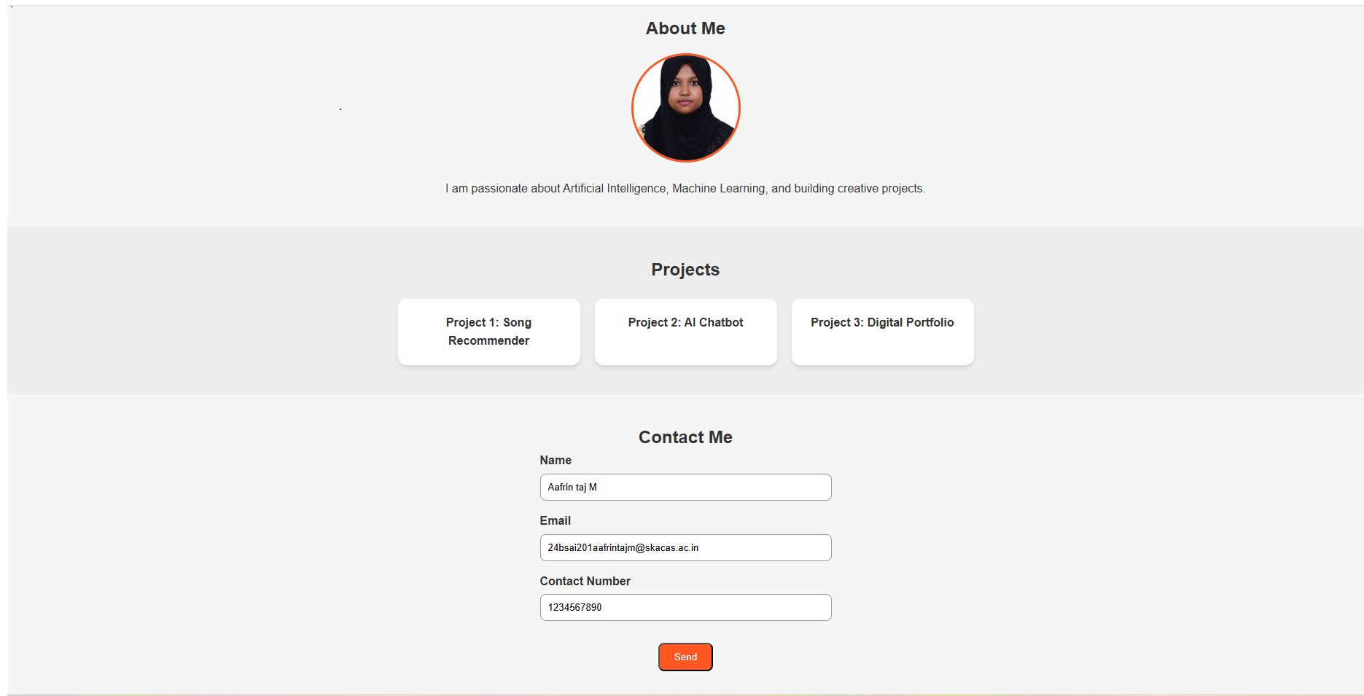

RESULTS AND SCREENSHOTS
3/21/2024 Annual Review
10

Slide 11
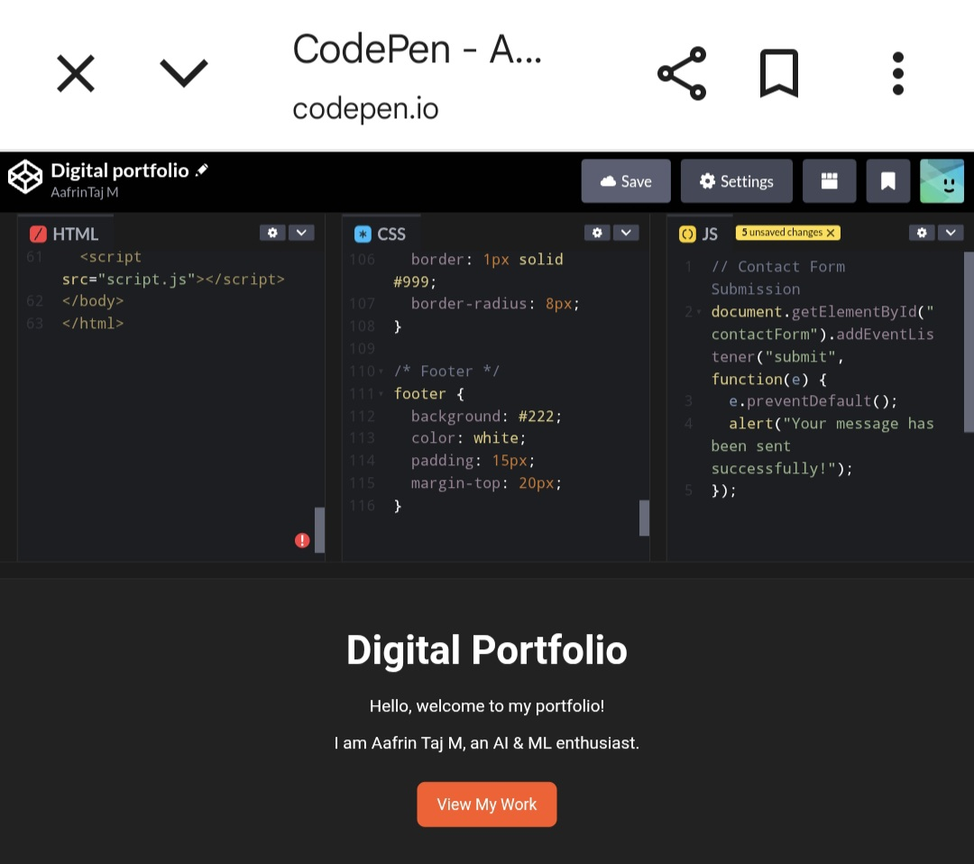

Slide 12
CONCLUSION
A digital portfolio is a modern and effective way to showcase personal skills, achievements, and work samples. It helps in building a strong professional identity, makes sharing easy, and allows employers or educators to quickly view your capabilities. Since it can be updated anytime, a digital portfolio remains a dynamic tool for career growth, academic success, and personal branding.
12

Slide 13
GITHUB LINK
https://github.com/Aafrintaj780/Aafrin-taj-m.git

